Slide 1
Course : T7043 – IT Services
Period : February 2018
Organizing for System Management
Session 02
D5664 – Dr. Eng. Antoni Wibowo

Slide 2
Term
Enterprise – an entire company, everything, all-inclusive
Systems – Information Technology Infrastructure, hardware and software, data, information, and processes
Management – The monitoring and controlling of entities
Service – Providing function to something or someone
Business Process or Process – The method used to perform tasks or jobs

Slide 3
Definition
Enterprise Systems Management - The complete and total management of a company's IT elements and/or environment
Enterprise Operational Process - The foundation and creation point for all management related services for the enterprise
Server OS - The operating system is responsible for running and managing the server. Some examples include Windows, Linux, Unix, etc
Application - A program run on a computer to satisfy a certain need under the OS (examples include Lotus Notes, Siebel, WebSphere)
Network - The layer of computing the is responsible for interconnecting IT elements
Database - An application primarily used for storing data
Bina Nusantara

Slide 4
Definitions
Process Layer - The layer in ESM containing the Operational Processes
Functional Layer - The layer in ESM containing the management disciplines for services
I/T Element Layer - The layer in ESM enumerating the I/T elements in the environment
Infrastructure Management - The discipline regarding services responsible for maintaining and managing the IT elements in an environment
Relationship Management - The discipline containing the services that are customer facing in relation to their IT infrastructure
Bina Nusantara

Slide 5
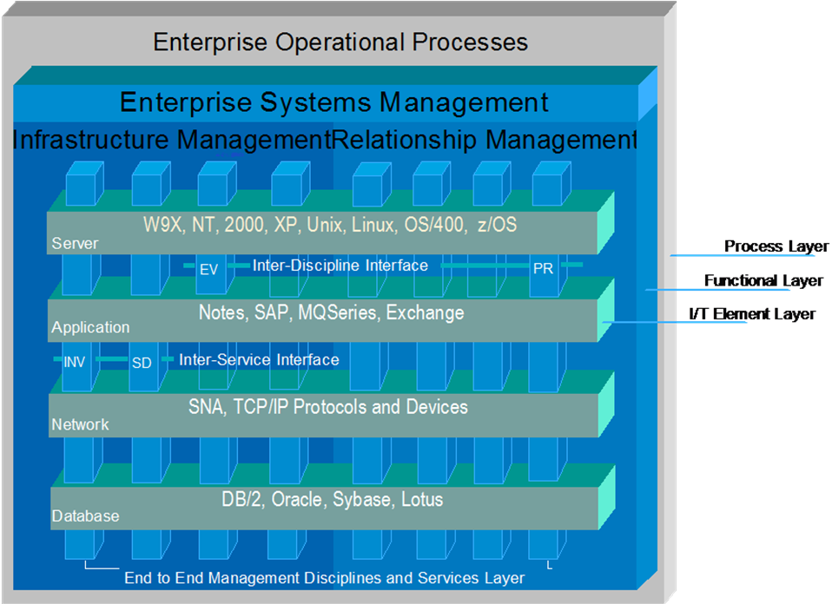
Definitions
Inter-Discipline Interface - Connection between two management disciplines
Inter-Service Interface - Connection between two services
Bina Nusantara

Slide 6
Enterprise System Management (ESM)
Session Service Definition

Slide 7
Services Definitions
Customer Service Center - The location where customer interact and interface with the IT provider
Command Center - The location where operators manage the IT environment
Subject Matter Experts (SME's) - Personnel trained in specific areas within the IT environment, such as application, network, os, etc
Project Office - The group within the IT provider matrix responsible for managing the revolving projects for a customer
Composite Elements - Disparate data collected to manage the IT infrastructure
Server/Application Elements - IT elements directly supporting the hw, os, and applications within the IT infrastructure
Network Elements - IT elements directly supporting the interconnections within the IT infrastructure
Bina Nusantara

Slide 8
Services Definitions
Capacity/Performance Management - The non-functional service regarding the long term trending of performance coupled with a knowledge of future load to predict needed capacity
Operations Management - The service responsible for directly managing the IT infrastructure based on user experience and event management outputs
Recovery Management - The service which manages the complete recovery of your IT infrastructure which is closely related to backup management
Security Management - The service managing the protection of your IT infrastructure from external attacks, and preventative measures taken to meet the same
Business Process Management - The service mapping IT elements to a customer's major business processes
Remote Control - The service managing IT elements remotely, usually through an agent to reduce downtime
Bina Nusantara

Slide 9
Services Definitions
Inventory - The service responsible for capturing the software and hardware information for a customer's IT environment
Reporting Management - The service responsible for collecting and displaying data to the infrastructure owners and customers
Request Management - The service responsible for retaining collecting and managing requests made of the IT environment
Bina Nusantara

Slide 10
Services Definitions
SLA Management - The service, which is closely tied into reporting management, responsible for capturing and displaying Service Level Agreement data
Knowledge Management - The service containing reusable standardized information used for reference and future engagements
Asset Management - The service is the combination of Remote Control, Inventory and Software Distribution services
Notification/Escalation Management - The service responsible for managing the appropriate notification based on event management outputs
Bina Nusantara

Slide 11
Services Definitions
Call/Problem Management - The service responsible for managing user deficiencies and alerting the appropriate parties
Change Management - The service managing the requests and completion of changes made to the IT infrastructure
End-User Experience Management - The service managing the non-functional (intangible qualities such as performance) customer requirements
Platform Management Systems - Systems within the IT infrastructure that manage the server and application IT elements
SNMP Management - The service responsible for managing SNMP (Simple Network Management Protocol) traffic
Bina Nusantara

Slide 12
Enterprise System Management (ESM)
Session IT SERVICE MANAGEMENT

Slide 13
IT Service Management
IT Service Management or Relationship Management - The discipline containing the services that are customer facing in relation to their IT infrastructure
  Reporting
  Request management
  Service level agreement management
  Knowledge management
  Asset management
  Notification
  Escalation
  Help desk
  Problem management
  Change management
Bina Nusantara

Slide 14
Enterprise System Management (ESM)
Session IT Infrastructure MANAGEMENT

Slide 15
IT Infrastructure Management
Infrastructure Management - The discipline regarding services responsible for maintaining and managing the IT elements in an environment
Infrastructure Management
  Backup
  Recovery
  Software distribution
  Configuration
  Event
  Availability
  Capacity
  Performance
Bina Nusantara

Slide 16
IT Infrastructure Management
Infrastructure Management
  Operations
  Disaster recovery
  Security
  Remote control
  Inventory
  Provisioning
  Storage
  License
  Business process
Bina Nusantara

